Slide 1

Department of Computer Science & Engineering
(Artificial Intelligence & Machine Learning)
A.P. Shah Institute of Technology
G.B. Road, Kasarvadavali, Thane (West) – 400615
University of Mumbai
Academic Year 2024 - 2025

Slide 2

CAPTION CRAFT
By:
Vaibhav Bura(22106067) Vivek Dalvi(22106108) Yash Desai(22106005) Pratik Dhas(22106063)
Guided By:
Prof. Poonam Tiware

Slide 3
Outline
Introduction
Literature Survey of the Existing Systems
Limitations of the Existing Systems
Problem Statement
Proposed System Design
Framework/Algorithm
Technologies Stack for Proposed System
Implementation(Partial)
Conclusion
References

Slide 4
INTRODUCTION
In today's digital world, millions of images are shared daily, often without adequate descriptive text.
Accurate and relevant captions are crucial for accessibility, content management, and user engagement.
Observed limitations in current AI-based image captioning models.
Caption Craft aims to develop an AI model that generates contextually rich and accurate captions.
Its goal is to develop a model that accurately describes images similar to human descriptions.
The project seeks to improve the effectiveness of image captions in real-world applications.

Slide 5
Literature survey of the existing system
G. Pereira et al. (2024) – “Vision Semantics Image Captioner”
This paper presents the Vision Semantics Image Captioner, a platform designed to generate detailed and contextually rich image descriptions. It aims to advance automated image captioning by integrating recent advancements in vision semantics and highlights practical applications in accessibility, content indexing, and assistive technologies. The paper also provides guidelines for system optimization and customization for various use cases.

Slide 6
Literature survey of the existing system
Vaishnavi T V et al. (2024) – “Remote Sensing Image Captioning using CNN and LSTM
This work presents a system for generating detailed captions for aerial images using an encoder-decoder approach. It combines Convolutional Neural Networks (CNNs) for visual encoding with Long Short-Term Memory (LSTM) networks for textual description, enhanced by the Bahdanau attention mechanism to focus on specific image regions. The system's performance was tested with four pre-trained CNNs on the UAVIC dataset.

Slide 7
Literature survey of the existing system
C. S. Kanimozhiselvi et al. (2022) – “Image Captioning using Deep Learning”
This research addresses the growing field of image captioning by developing a model that combines various Convolutional Neural Network (CNN) architectures with Long Short-Term Memory (LSTM) networks to improve captioning accuracy. The model uses three CNN architectures—Inception-v3, Xception, and ResNet50—for feature extraction and LSTM for generating captions. The best-performing combination is selected based on model accuracy and trained on the Flicker8k dataset.

Slide 8
Limitations of existing system
Contextual Understanding : Existing systems often struggle with understanding complex scenes or contextual subtleties, leading to less accurate or overly generic captions.
Computational Resources : High computational demands for training and inference, often requiring substantial hardware and energy resources.
Generalization : Models may not generalize well to new or diverse datasets, especially when trained on limited or homogeneous data.
Lack of Fine – Grained Descriptions : Limited capability in generating detailed or fine – grained descriptions that capture intricate details or subtle interactions between objects.

Slide 9
Problem statement
To develop an automated image caption generator using convolutional neural networks that can analyze and describe the content of images with accurate and contextually relevant textual descriptions. The system aims to accurately describe images similar to human descriptions.

Slide 10
Proposed system design
.
Prepare Dataset
Vectorizing text data
Building pipeline for training
Text Prediction
Model Training
Building the model

Slide 11
framework / algorithm
Convolutional Neural Network (CNN)
A Convolutional Neural Network (CNN) is a type of deep learning model that is particularly effective for tasks involving image data. In the context of your image captioning project, a CNN is used to process the image data and extract meaningful features that can be used by the model to generate accurate captions.

Slide 12

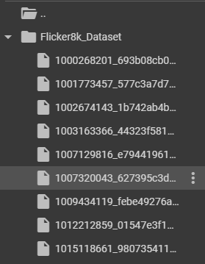


DATA PREPROCESSING
By jason brownlee
Fliker8k_Dataset.zip: Contains images
Around 8 thousand
Fliker8k_text.zip: Contains
captions in text format
We are using image caption pairs for training the model
The dataset consists of images paired with five different captions.

Slide 13


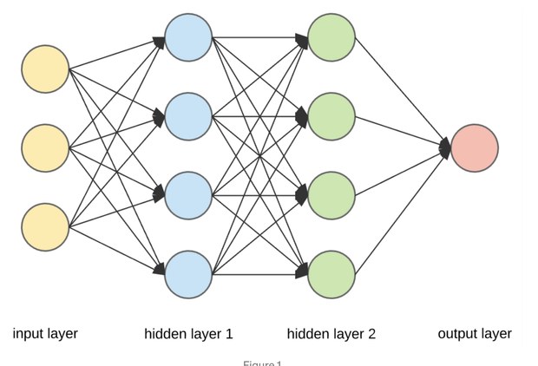
TECHNOLOGY STACK FOR PROPOSED SYSTEM
TensorFlow’s Text Vectorization layer :
converting text into numerical representations that can be processed for training models.
It contains around 8 thousand images and text file which contains captions
CNN OR VGG16

Slide 14
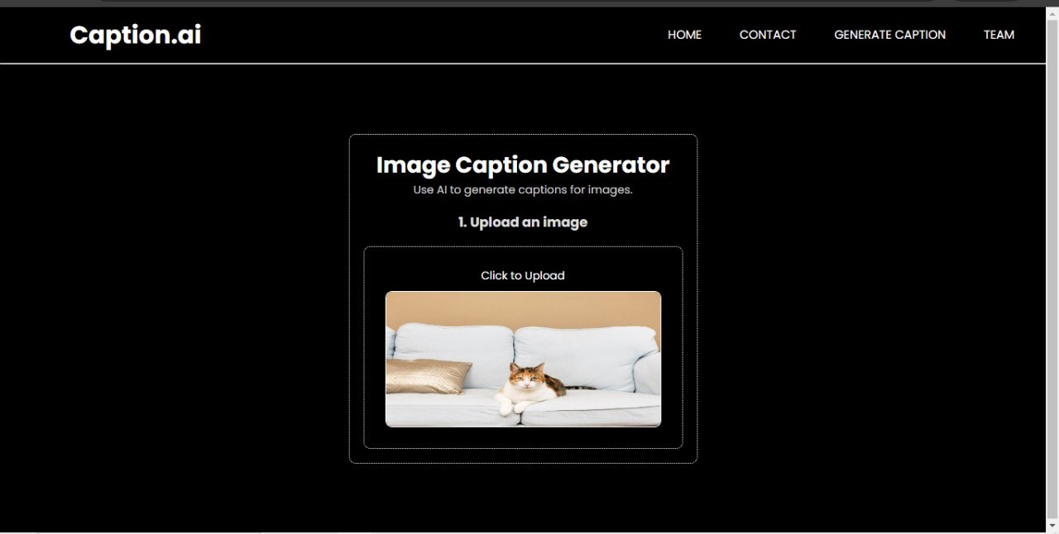
implementation

Slide 15
conclusion
In conclusion, using Convolutional Neural Networks (CNNs) for image caption generation effectively leverages their powerful feature extraction capabilities to analyze and understand visual content. This integration not only enhances user experience and accessibility but also streamlines content management and digital media applications, showcasing the potential of artificial intelligence in bridging visual and textual information.

Slide 16
references
[1] G. Pereira, R. Kundar, D. Kushwaha and P. Shaikh, "Vision Semantics Image Captioner," 2024 IEEE International Conference on Information Technology, Electronics and Intelligent Communication Systems (ICITEICS), Bangalore, India, 2024, pp. 1-7, https://doi.org/10.1109/ICITEICS61368.2024.10625415
[2] V. T V and I. C, "Remote Sensing Image Captioning using CNN and LSTM," 2024 International Conference on Advancements in Power, Communication and Intelligent Systems (APCI), KANNUR, India, 2024, pp. 1-6,
https://doi.org/10.1109/APCI61480.2024.10616900
[3] C. S. Kanimozhiselvi, K. V, K. S. P and K. S, "Image Captioning Using Deep Learning," 2022 International Conference on Computer Communication and Informatics (ICCCI), Coimbatore, India, 2022, pp. 1-7, https://doi.org/10.1109/ICCCI54379.2022.9740788

Slide 17
Thank You!

